Slide 1
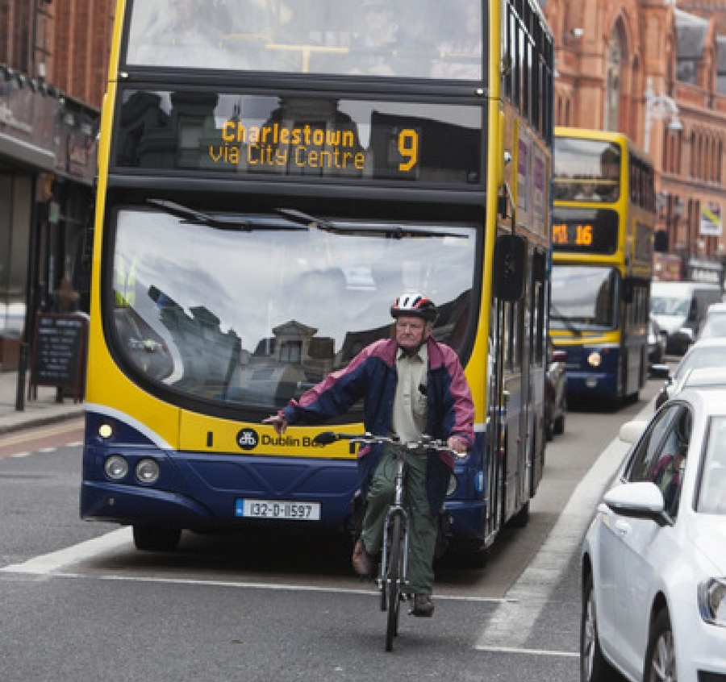
The Problem
In the UK:
1.9 million people cycle every day/nearly every day (aged 18+)
2.6 million people cycle between 2 and 5 days per week (aged 18+)
18,477 cyclists were injured in reported road accidents in 2016
3,499 were killed or seriously injured
http://www.thejournal.ie/poll-fine-for-drivers-cycling-3252087-Feb2017/
https://www.cyclinguk.org/resources/cycling-uk-cycling-statistics#How many people cycle and how often?
https://www.rospa.com/road-safety/advice/pedal-cyclists/facts-figures/

Slide 2



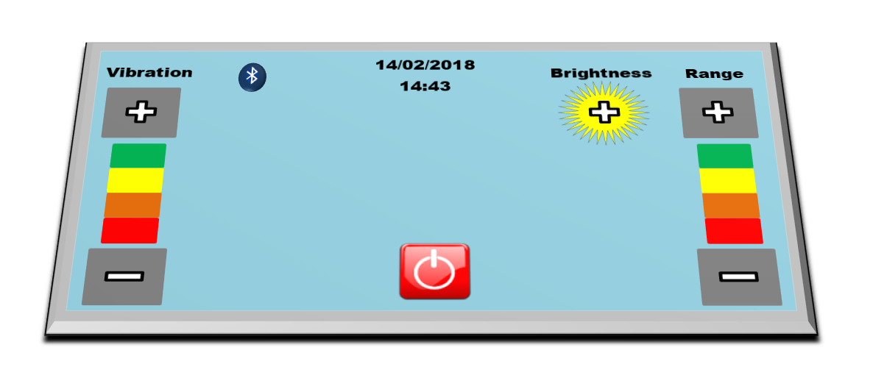


Our Solution
PiCycle S.E.A.T
Current solutions: Wearable rear-view mirrors which take concentration off the road
Situational and Environmental Awareness Technology

